Slide 1
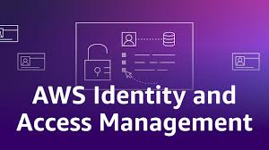

Slide 2
What is AWS IAM?
AWS Identity and Access Management (IAM) enables secure control over access to AWS services and resources.
Manages WHO can access AWS (authentication).
Controls WHAT they can do (authorization).
Defines HOW they can access (policies & permissions).

Slide 3
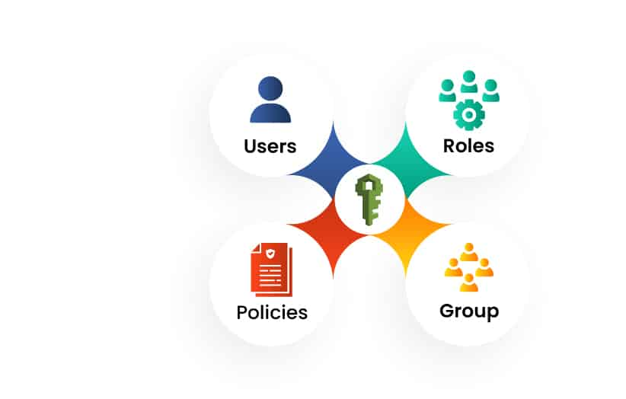

Slide 4
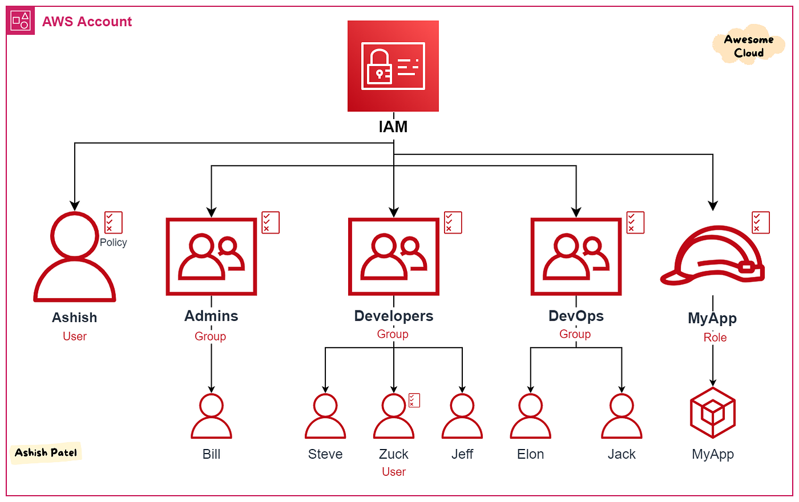
IAM Workflow
User
Group
Role
Policy
AWS Resources

